Slide 1


BIOINFORMATICS COURSE
Functional analysis of gene lists
A practical exploration of resources
Bioinformatics Course UEB-VHIR
November 2020
Ricardo Gonzalo¹, Mireia Ferrer¹, Álex Sánchez^{1,2}
Berta Miró¹, Angel Blanco^{1,2}
1 Unitat d’Estadística i Bioinformàtica (UEB) VHIR
2 Departament de Genètica Microbiologia i Estadística, UB

Slide 2
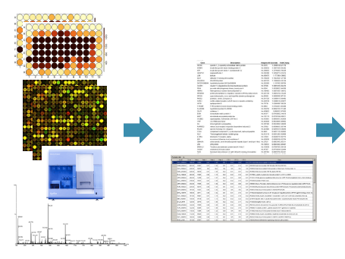

Functional Analysis of gene lists
What’s the biology behind a list of genes ?
From individual genes
From groups of genes

Slide 3
Functional Analysis of gene lists
TABLE OF CONTENTS
Resources for functional analysis of gene lists
Navigating through different resources
Browsing the GO
Pathway visualization in Reactome
Case of study: RNA-seq experiment (airway data)
Preparation of the gene list
Functional annotation of individual genes
Overrepresentation analysis of top DEG (g:Profiler / Reactome analysis tool)
Visualization and downstream analyses
A workflow in R (clusterProfileR)
Notes:
3

Slide 4
Resources for functional analysis

Slide 5
Resources for functional analysis
Web tools
g:Profiler - http://biit.cs.ut.ee/gprofiler/index.cgi
Reactome - https://reactome.org/
DAVID - http://david.abcc.ncifcrf.gov/tools.jsp
GeneMANIA - http://www.genemania.org/
WebGestalt - http://webgestalt.org/
AmiGO - http://amigo.geneontology.org/amigo
QuickGO - https://www.ebi.ac.uk/QuickGO/
ReviGO - http://revigo.irb.hr/
GSEA - http://software.broadinstitute.org/gsea/index.jsp
ClueGO - http://apps.cytoscape.org/apps/cluego
PANTHER - http://pantherdb.org/
GOrilla – http://cbl-gorilla.cs.technion.ac.il/

Slide 6
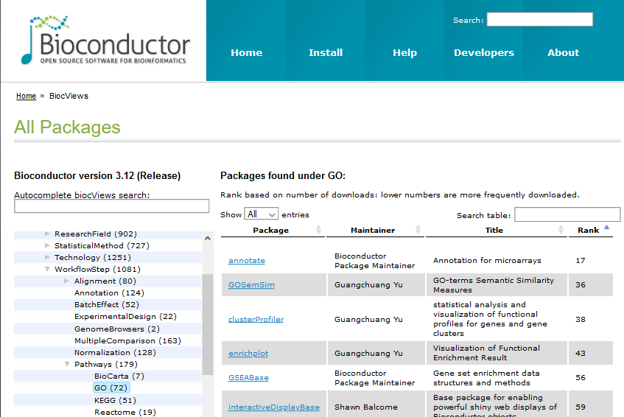
Resources for functional analysis
R packages
clusterProfiler - http://bioconductor.org/packages/release/bioc/html/clusterProfiler.html
GAGE/Pathview - http://www.bioconductor.org/packages/release/bioc/html/gage.html
SPIA - https://www.bioconductor.org/packages/release/bioc/html/SPIA.html
WGCNA - https://horvath.genetics.ucla.edu/html/CoexpressionNetwork/Rpackages/WGCNA/
http://bioconductor.org/packages/release/BiocViews.html#___Pathways

Slide 7
Resources for functional analysis
Considerations when choosing a tool
Type of analysis performed
Annotation
Enrichment analysis (Overrepresentation vs GSEA)
Network-based analyses
Coexpression, ...
Statistical test performed, algorithms used, multiple testing adjustment
Source of information
Available genesets, databases
Updated? Curated?
Organisms supported
Input data accepted
Genes, miRNA, SNPs, metabolomics
Flexibility in managing different types of Ids
Output, visualisation, post-processing

Slide 8
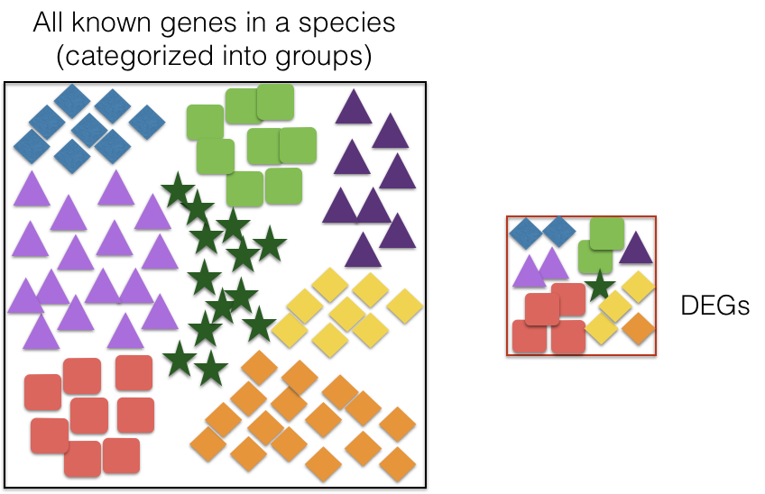
Resources for functional analysis
Resources of functional annotations
Functional annotations can be very diverse: molecular functions, pathways (genes that work together to carry out a biological process), interactions, gene regulation, involvement in disease…
Collections of gene sets
The Gene Ontology
Pathway databases
Disease-related DB
Cell/tissue markers
Chromosome locations
Transcription factor DB
Micro-RNA / targets DB

Slide 9
Resources for functional analysis
Resources of functional annotations
Gene Ontology (GO)
Cellular Components / Biological Processes / Molecular Function
Pathways Databases
KEGG, Reactome, WikiPathways PantherDB
Disease-related
DisGeNet, Disease Ontology
Cell/Tissue markers databases
CellMarker, Cellfinder
Chromosomal location
Transcription Factors binding sites DBs, TRANSFAC
MicroRNA-Target interactions DB

Slide 10
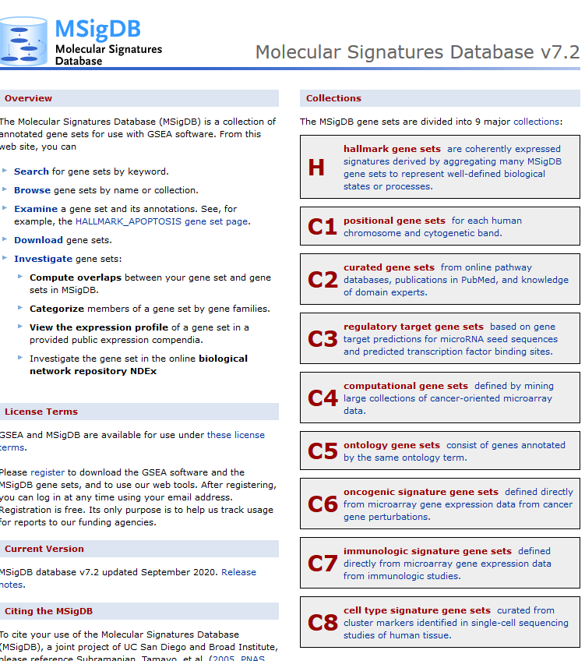
Resources for functional analysis

Slide 11
Browsing the Gene Ontology

Slide 12
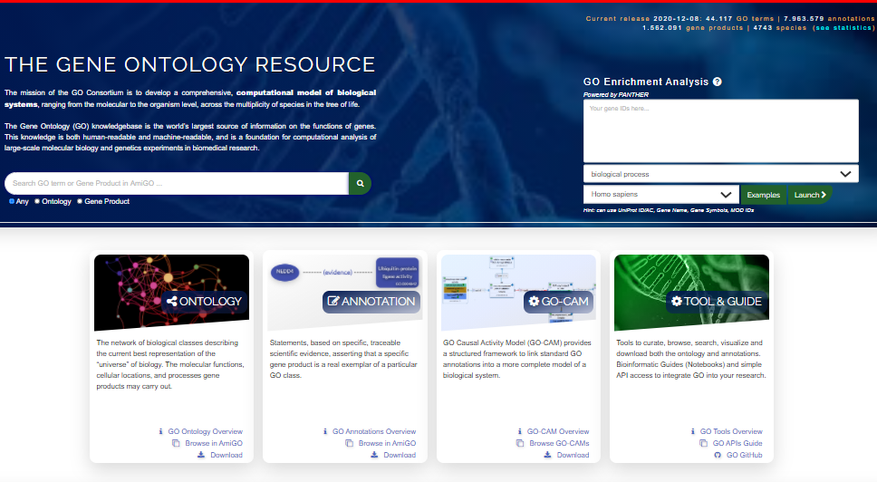
Functional Analysis of gene lists
Notes:
12

Slide 13
Queries that can be done with the GO
Functional Analysis of gene lists
AmiGO / QuickGO
Hierarchy
Search for a term like apoptosis
Search for the annotations of a given gene
Do enrichment analysis of a gene list
Notes:
13

Slide 14
Browsing the Reactome Pathways database

Slide 15
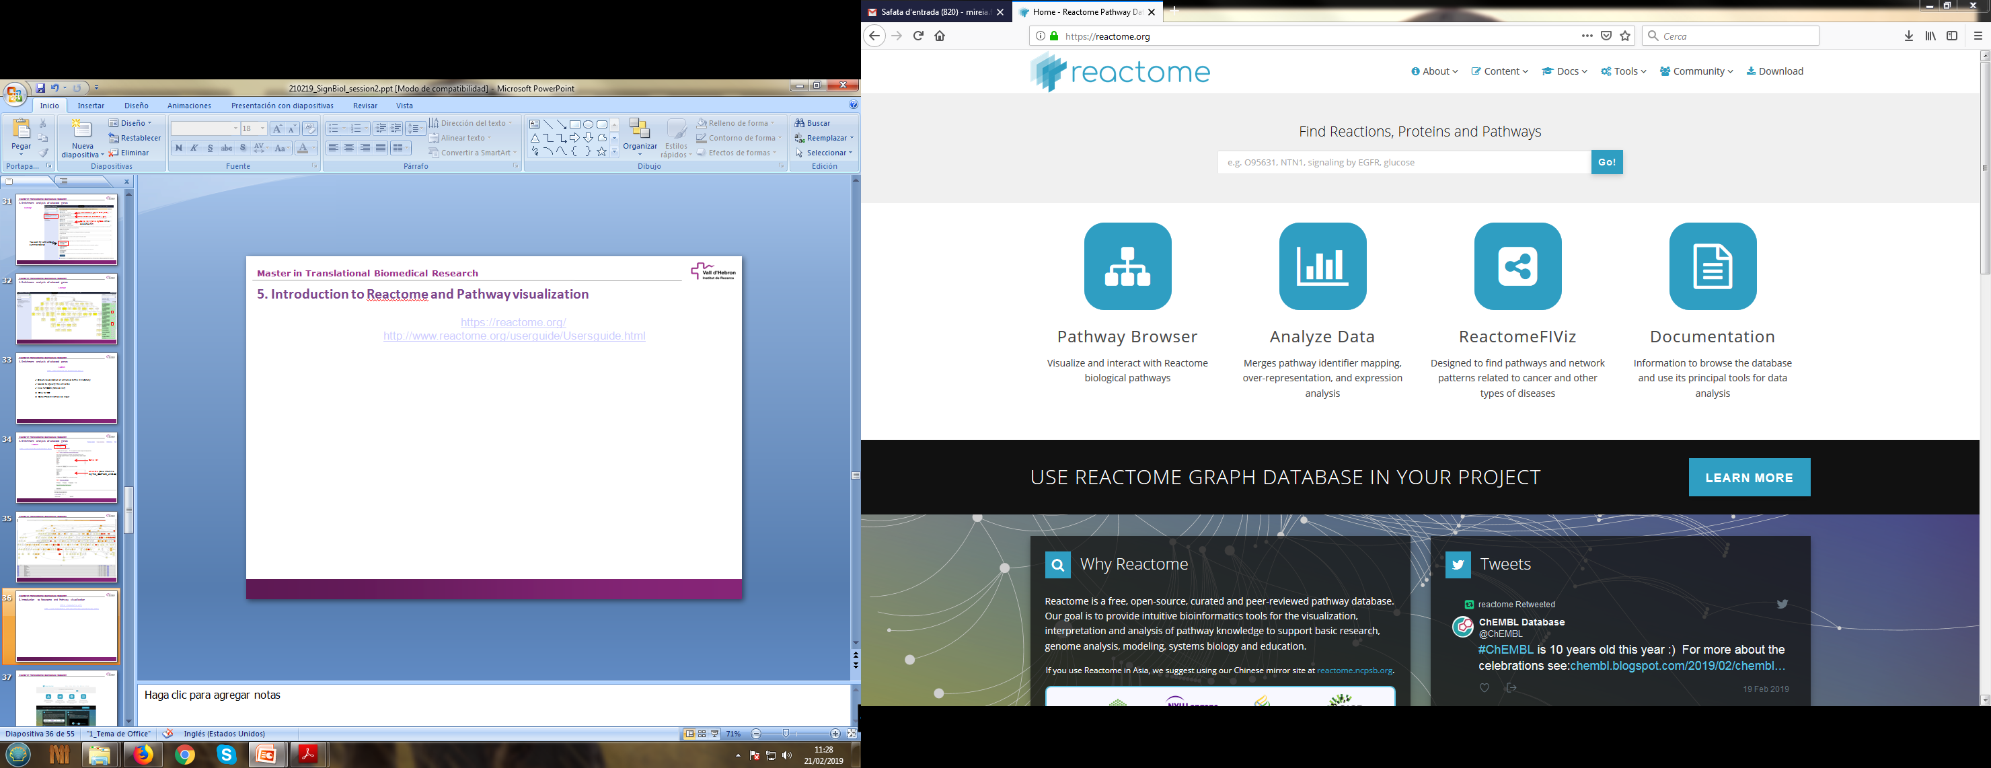
5. Introduction to Reactome and Pathway visualization
https://reactome.org/
Tutorials: http://www.reactome.org/userguide/Usersguide.html
https://www.ebi.ac.uk/training/online/

Slide 16
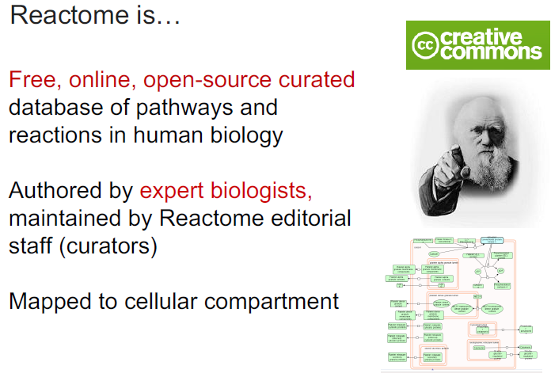
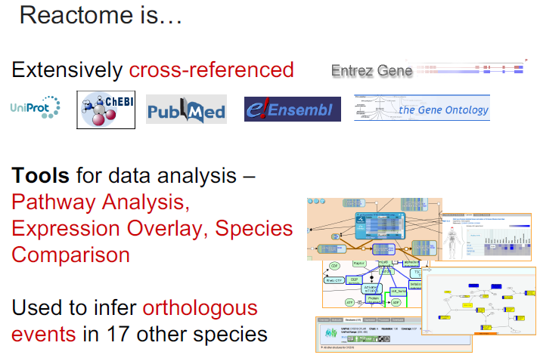
5. Introduction to Reactome and Pathway visualization

Slide 17
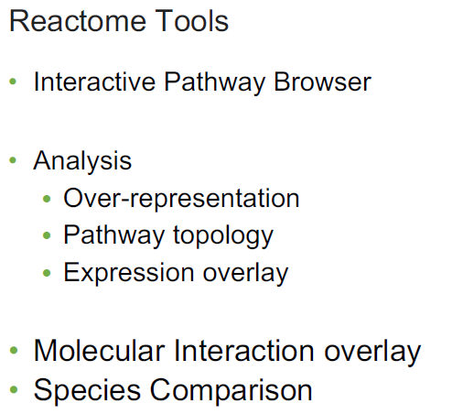
5. Introduction to Reactome and Pathway visualization

Slide 18
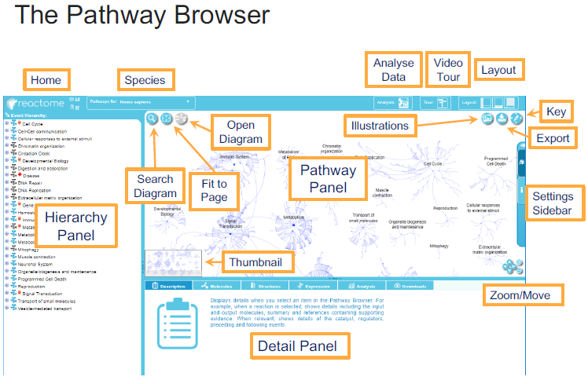
5. Introduction to Reactome and Pathway visualization

Slide 19
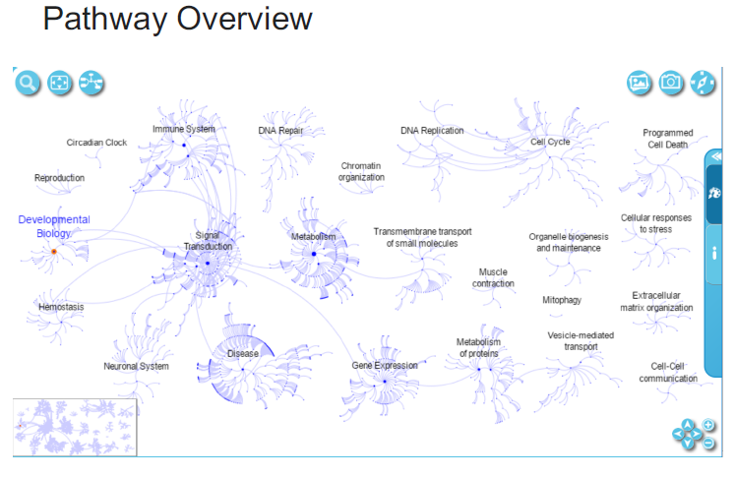
5. Introduction to Reactome and Pathway visualization

Slide 20
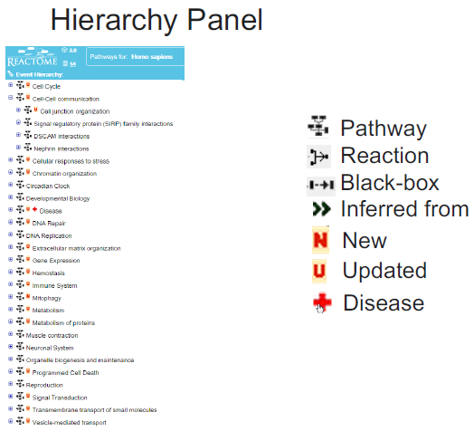
5. Introduction to Reactome and Pathway visualization

Slide 21
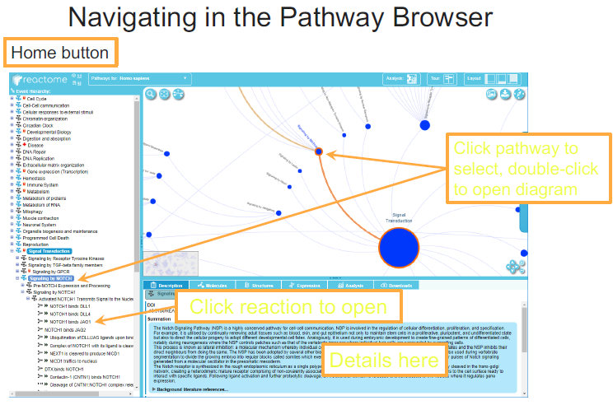
5. Introduction to Reactome and Pathway visualization

Slide 22
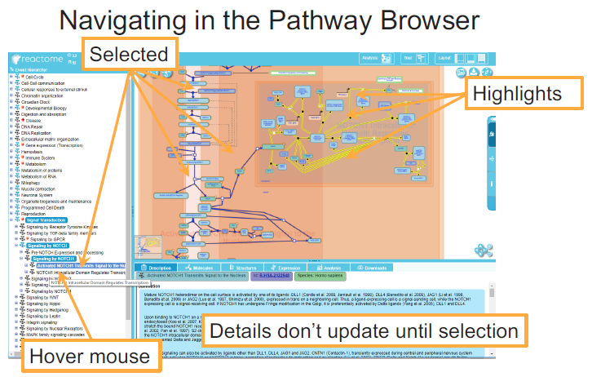
5. Introduction to Reactome and Pathway visualization

Slide 23
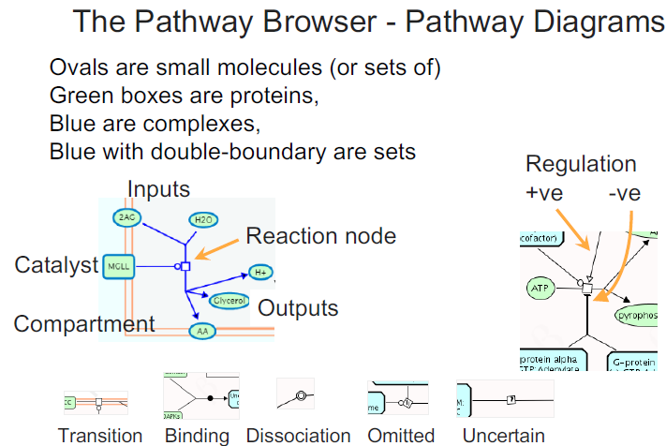
5. Introduction to Reactome and Pathway visualization

Slide 24
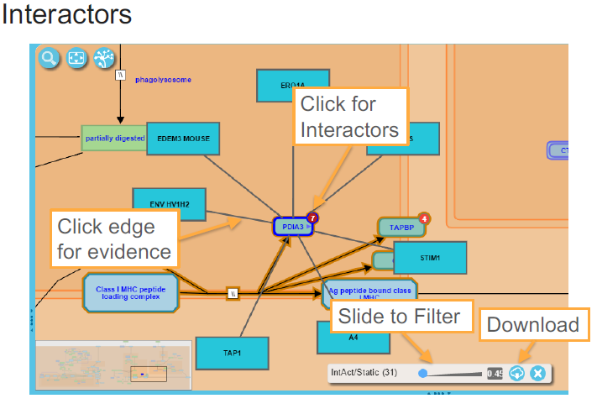
5. Introduction to Reactome and Pathway visualization

Slide 25
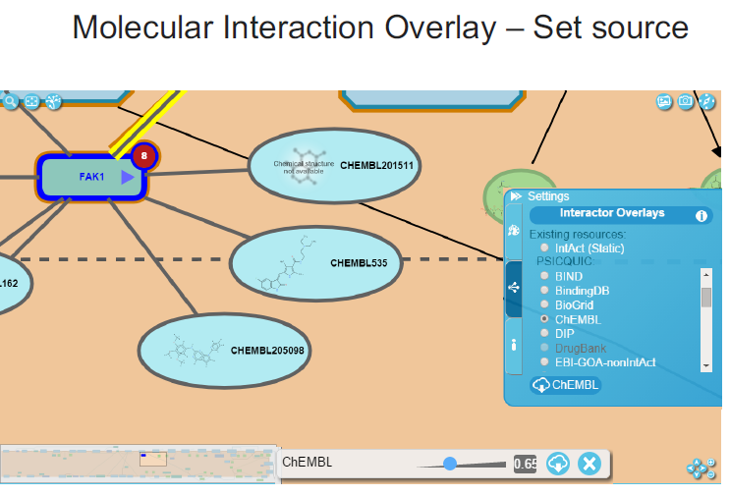
5. Introduction to Reactome and Pathway visualization

Slide 26
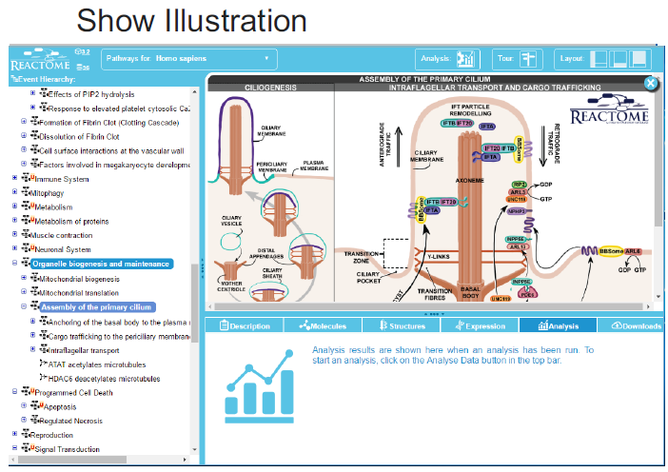
5. Introduction to Reactome and Pathway visualization

Slide 27
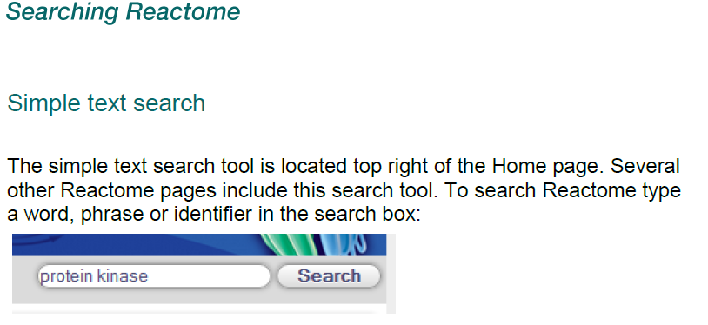
5. Introduction to Reactome and Pathway visualization
Searching the Reactome
Different types of results (Pathway, Reactions, Prot…)

Slide 28
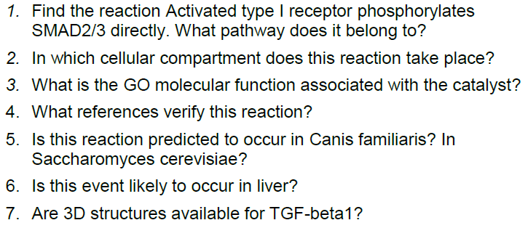
5. Introduction to Reactome and Pathway visualization
Searching the Reactome

Slide 29
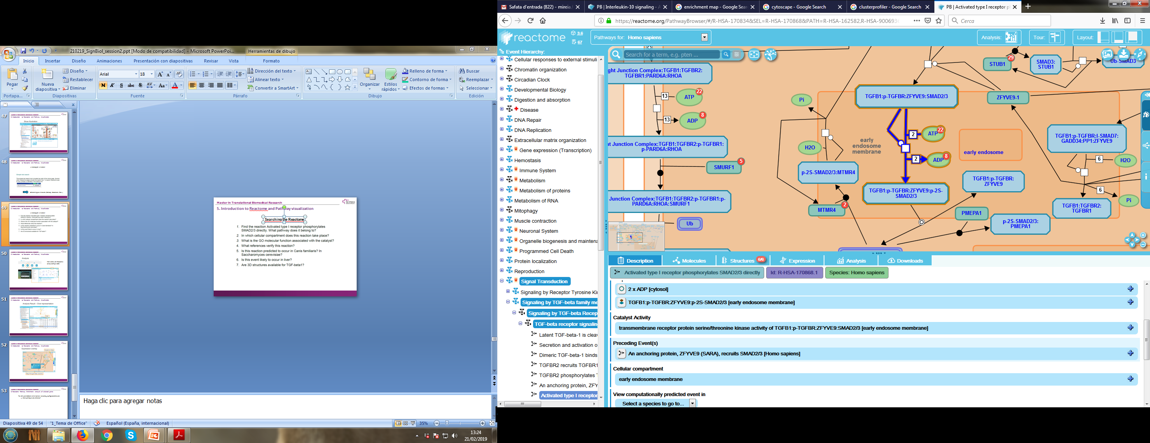

Slide 30
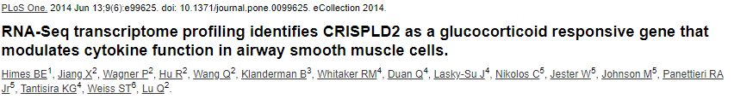
Case Study

Slide 31
Introduction to Functional Analysis
The differential expression analysis performed on RNA-seq data (airway dataset) returned some genes differentially expressed in DEX-Treated vs Untreated cells. We want now to extract some biological meaning from these lists, such as which biological processes or pathways the differentially expressed genes are implicated in.
res <- results(dds, contrast=c("dex","trt","untrt"))
res
log2 fold change (MLE): dex trt vs untrt
Wald test p-value: dex trt vs untrt
DataFrame with 31604 rows and 6 columns
baseMean log2FoldChange lfcSE stat pvalue padj
<numeric> <numeric> <numeric> <numeric> <numeric> <numeric>
ENSG00000000003.14 739.940717 -0.3611537 0.106869 -3.379419 0.000726392 0.00531137
ENSG00000000419.12 511.735722 0.2063147 0.128665 1.603509 0.108822318 0.29318870
ENSG00000000457.13 314.194855 0.0378308 0.158633 0.238479 0.811509461 0.92255697
ENSG00000000460.16 79.793622 -0.1152590 0.314991 -0.365912 0.714430444 0.87298038
ENSG00000000938.12 0.307267 -1.3691185 3.503764 -0.390757 0.695977205 NA
... ... ... ... ... ... ...
ENSG00000285979.1 38.353886 0.3423657 0.359511 0.952310 0.340940 0.600750
ENSG00000285987.1 1.562508 0.7064145 1.547295 0.456548 0.647996 NA
ENSG00000285990.1 0.642315 0.3647333 3.433276 0.106235 0.915396 NA
ENSG00000285991.1 11.276284 -0.1165515 0.748601 -0.155692 0.876275 0.952921
ENSG00000285994.1 3.651041 -0.0960094 1.068660 -0.089841 0.928414 NA

Slide 32
Introduction to Functional Analysis
Exercise 2
Prepare a Gene List with the “top” up-regulated genes and one with the “top” down-regulated genes according to the following statistical criteria:
Up-regulated genes: genes with an adjusted p-value < 0.05 AND logFC > 2
Down-regulated genes: genes with an adjusted p-value < 0.05 AND logFC < -2
Tip: You can use excel (with caution) or R to filter your TopTable
Under these criteria, how many genes are up-regulated? And how many down-regulated?
What is the Entrez ID of your top most up/down-regulated gene? And its UniProt ID (SwissProt)?
Tip: You can use g:Convert tool from g:Profiler for ID conversion

Slide 33
Functional annotation of individual genes
Id mapping
Searching for a gene in different databases

Slide 34
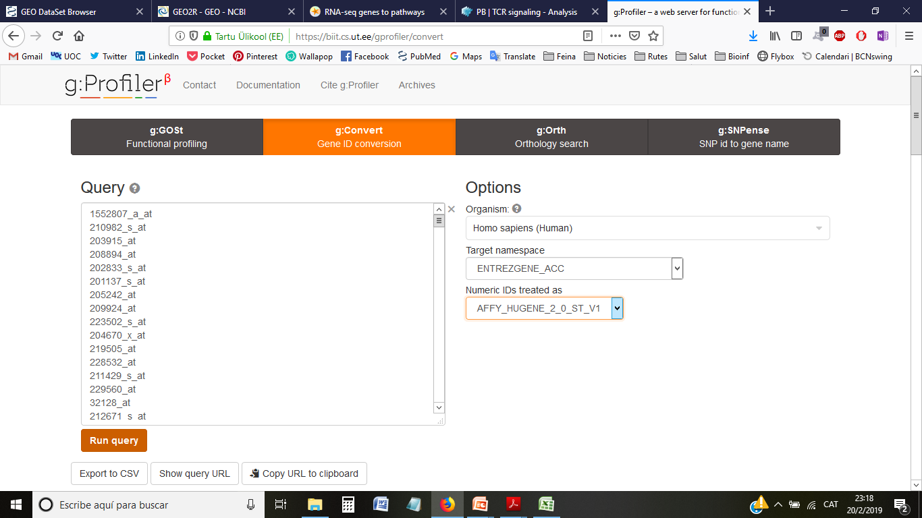
2. Preparation of the Gene list
ID mapping with g:Profiler
Output
Input

Slide 35
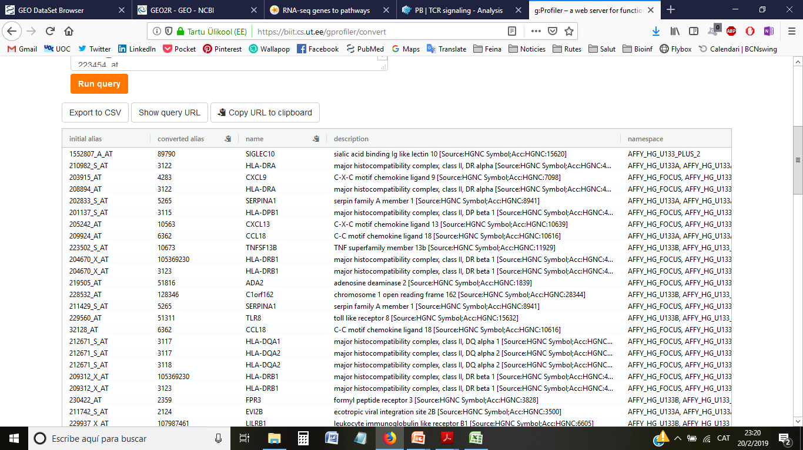
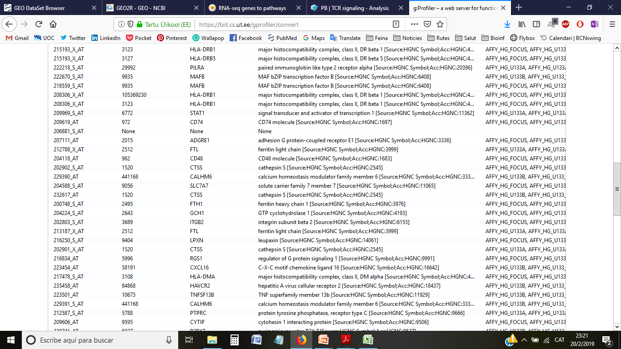
2. Preparation of the Gene list
ID mapping with g:Profiler
Export results as gProfiler_IDconvert_GSE7586_sel.csv
Some ambiguities
Some missing

Slide 36
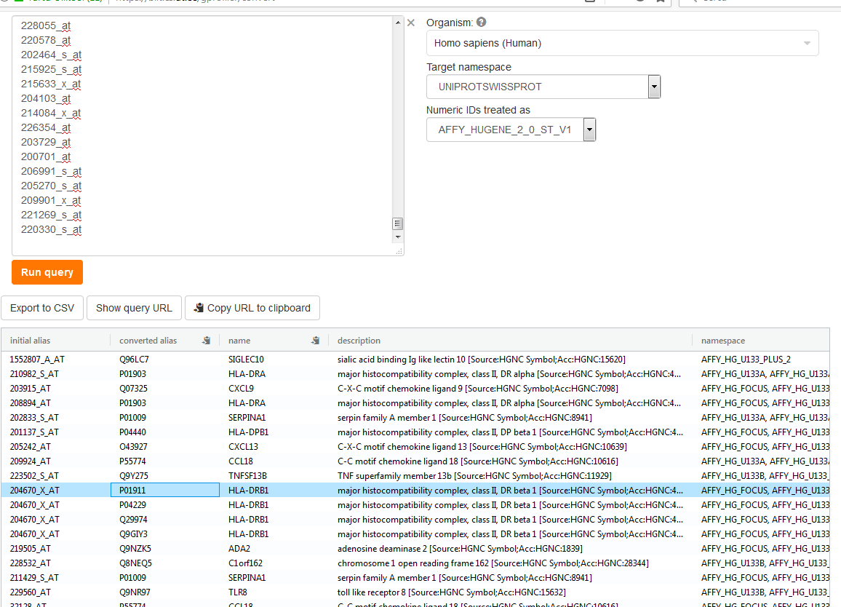
2. Preparation of the Gene list
ID mapping with g:Profiler
Different protein isoforms
(check in UniProt)

Slide 37
3. Functional annotation of individual genes
What is known of gene X?
Get information for one of the genes in some database (Pubmed, UniProt, NCBI-Gene…)
Look for GO terms (CC, MF, BP) associated to your favorite gene:
Tip: Search by gene/protein symbol in QuickGO: https://www.ebi.ac.uk/QuickGO/

Slide 38
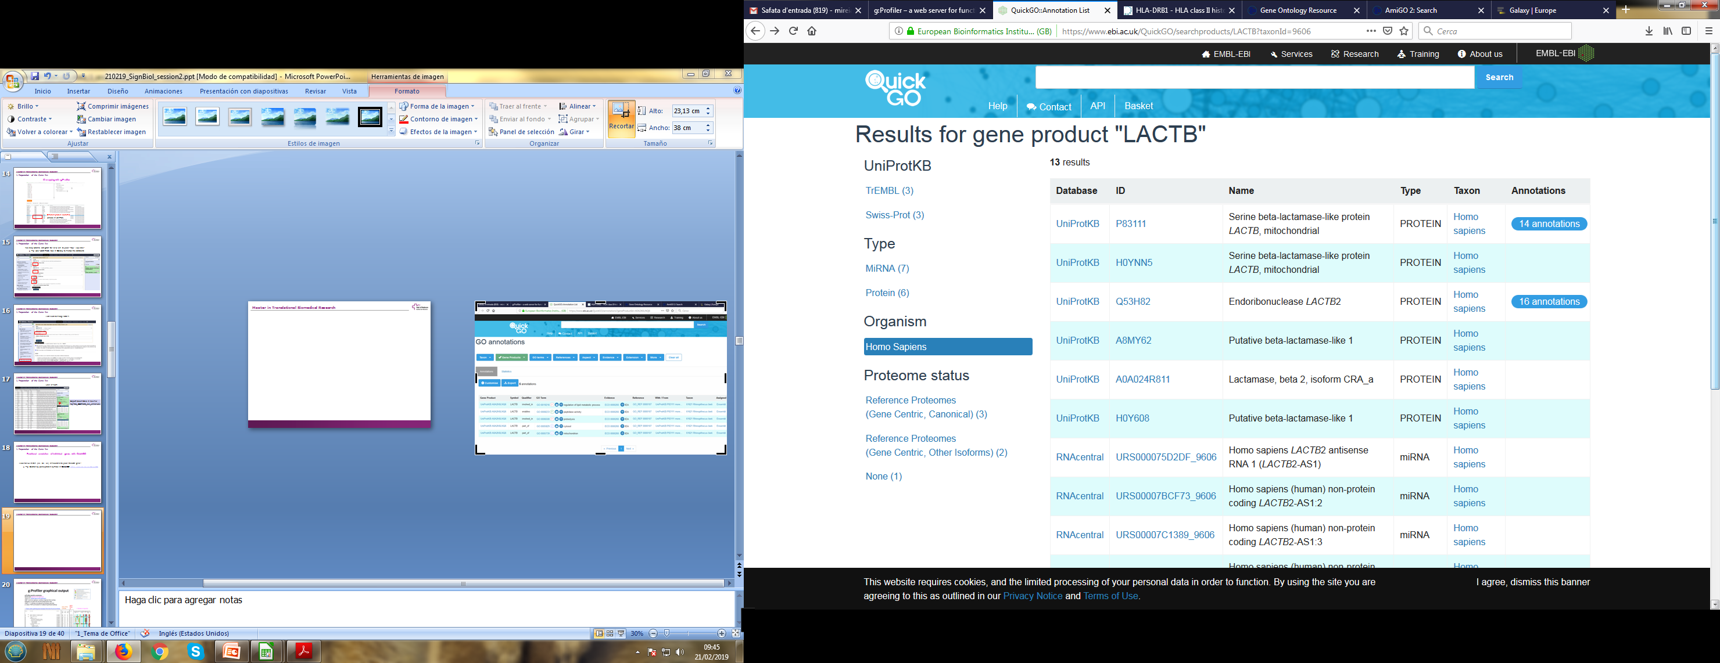
3. Functional annotation of individual genes
Functional annotation of individual genes with QuickGO

Slide 39
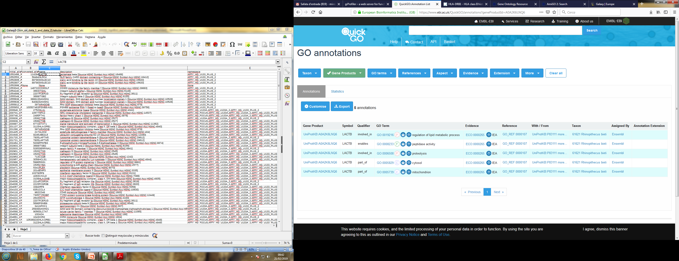
3. Functional annotation of individual genes
Functional annotation of individual genes with QuickGO
Biological Process?
Molecular function?
Cellular localization?

Slide 40
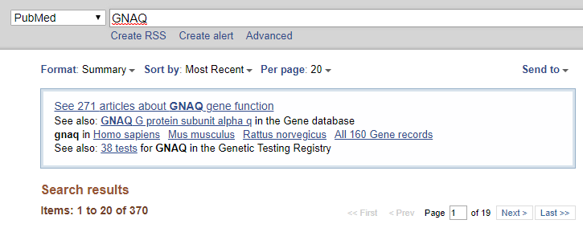


3. Functional annotation of individual genes
Note that doing this for every one of your genes may take you some long time…

Slide 41
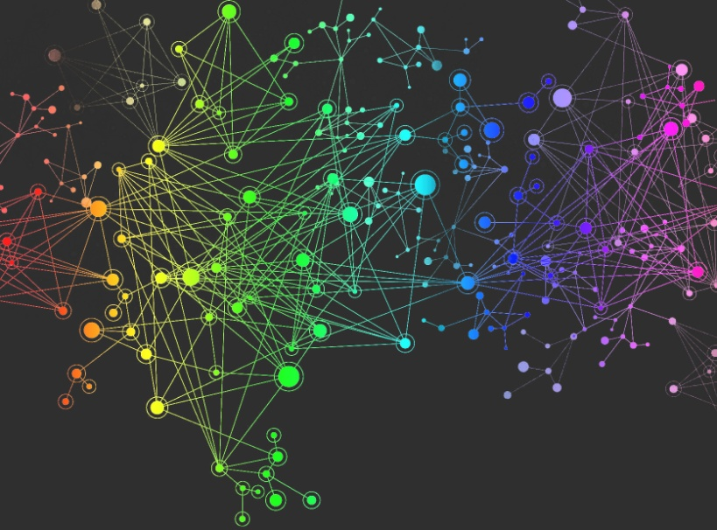
4. Enrichment analysis of selected genes
Genes usually don’t act on their own
Extracting information at the “group” level may be more meaningful and facilitate interpretation of the processes involved in the condition of study

Slide 42
Overrepresentation analysis
G:profiler
Gorilla
Reactome

Slide 43
you can determine the probability of having the observed proportion of genes associated with a specific category in your gene list based on the proportion of genes associated with the same category in the background set (gene categorizations for the appropriate organism).
Gene list

Slide 44
4. Enrichment analysis of selected genes
What do we need?
Selected genes from topTable
Our list of genes
The universe from which comes our list of genes
Gene sets of annotations
Structure of relationships between annotation terms
Remaining genes in microarray/genome
From annotation database
(eg. .gaf file for GO)
http://geneontology.org/docs/download-go-annotations/
From annotation database
(eg. .obo file for GO)
http://geneontology.org/docs/download-ontology/

Slide 45
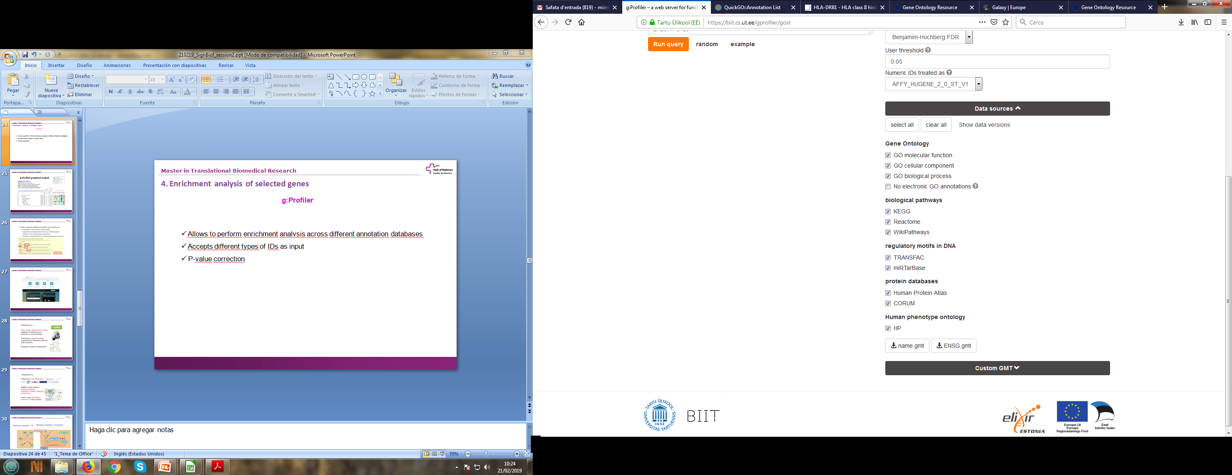
4. Enrichment analysis of selected genes
g:Profiler
Allows to perform enrichment analysis across different annotation databases
Accepts different types of IDs as input
Adjustment for multiple comparisons
Source of evidence (experimental, computational, …)

Slide 46
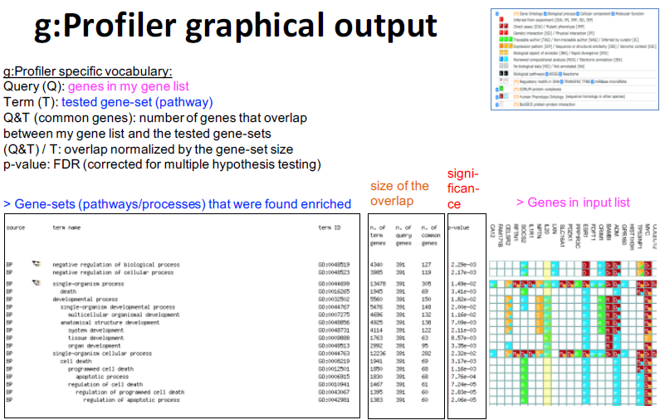
4. Enrichment analysis of selected genes
g:Profiler

Slide 47
4. Enrichment analysis of selected genes
g:Profiler
What GO or Reactome terms are enriched in your gene list?
Tip: Use g:GOSt tool in g:Profiler for functional enrichment analysis

Slide 48
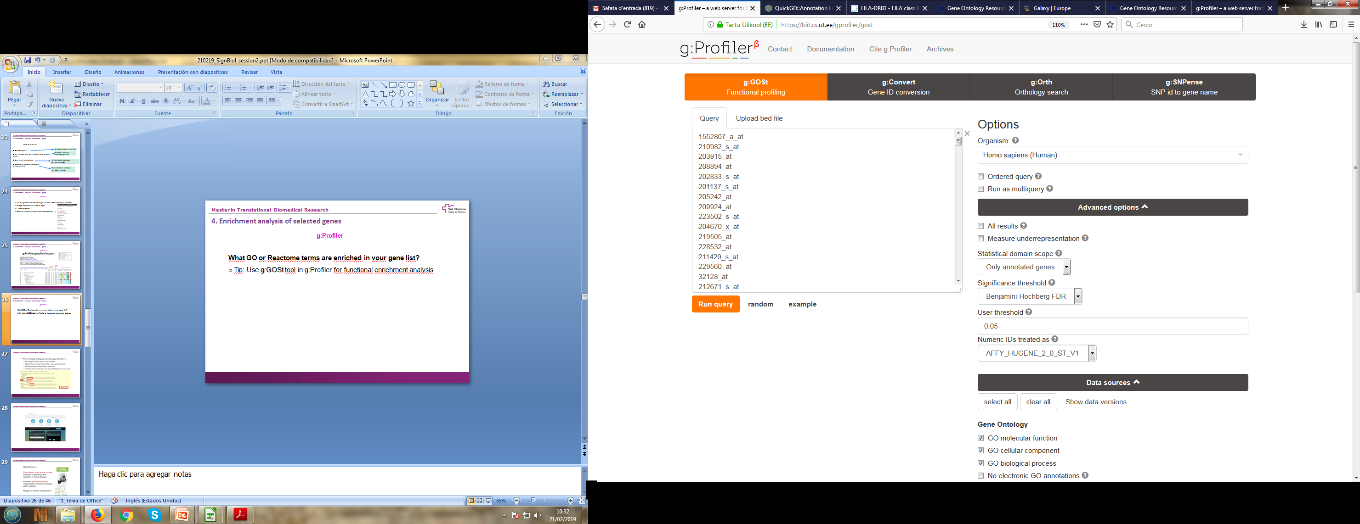
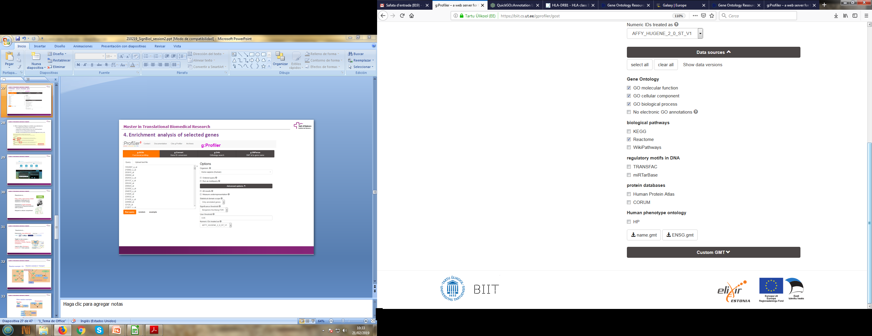
4. Enrichment analysis of selected genes
g:Profiler
Gene list
Universe
databases
Statistical
threshold

Slide 49
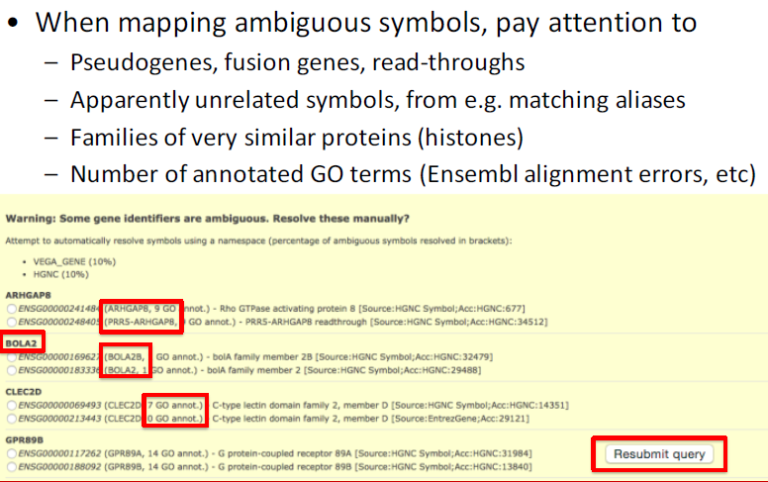
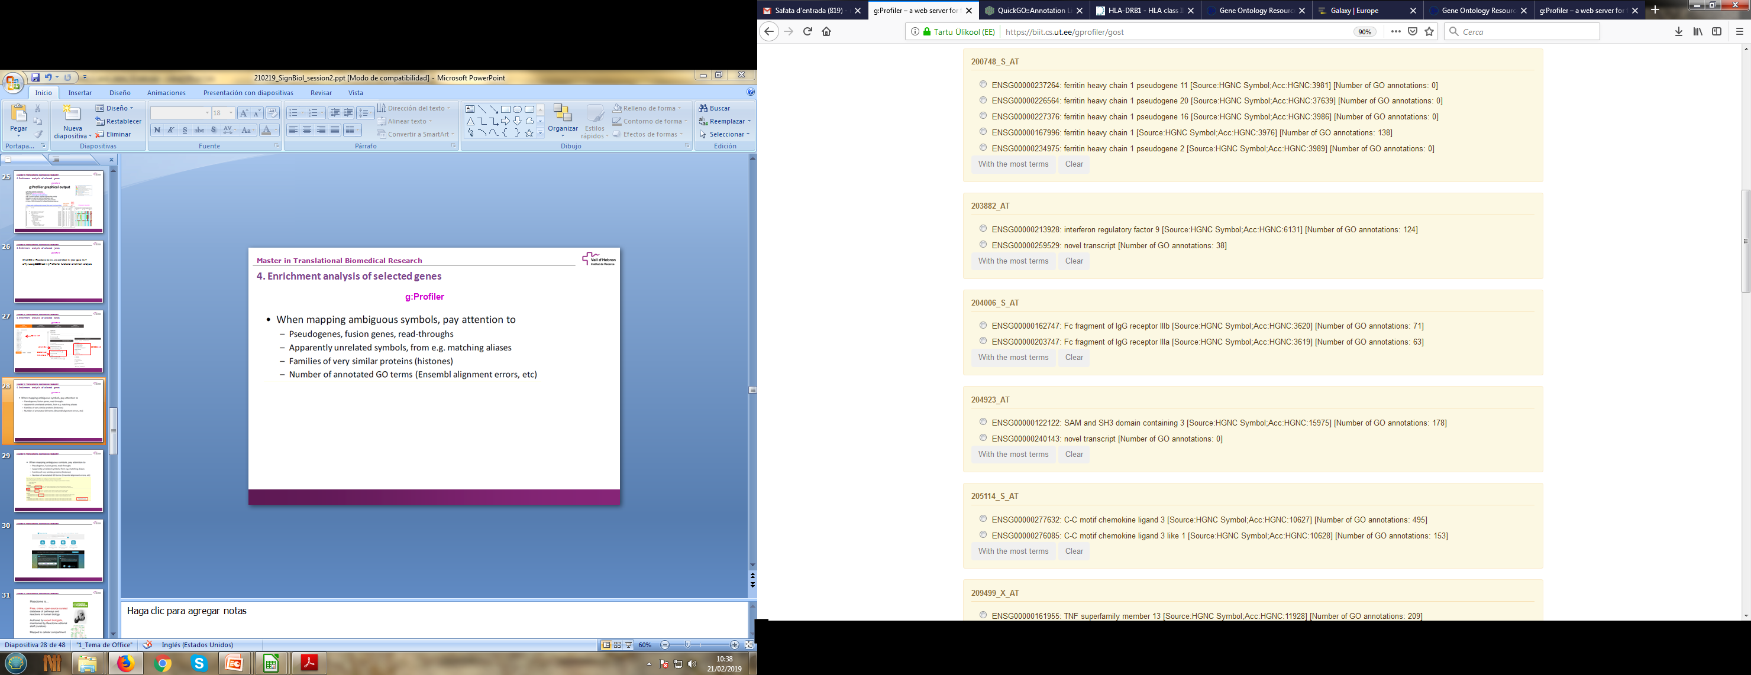
4. Enrichment analysis of selected genes
g:Profiler

Slide 50
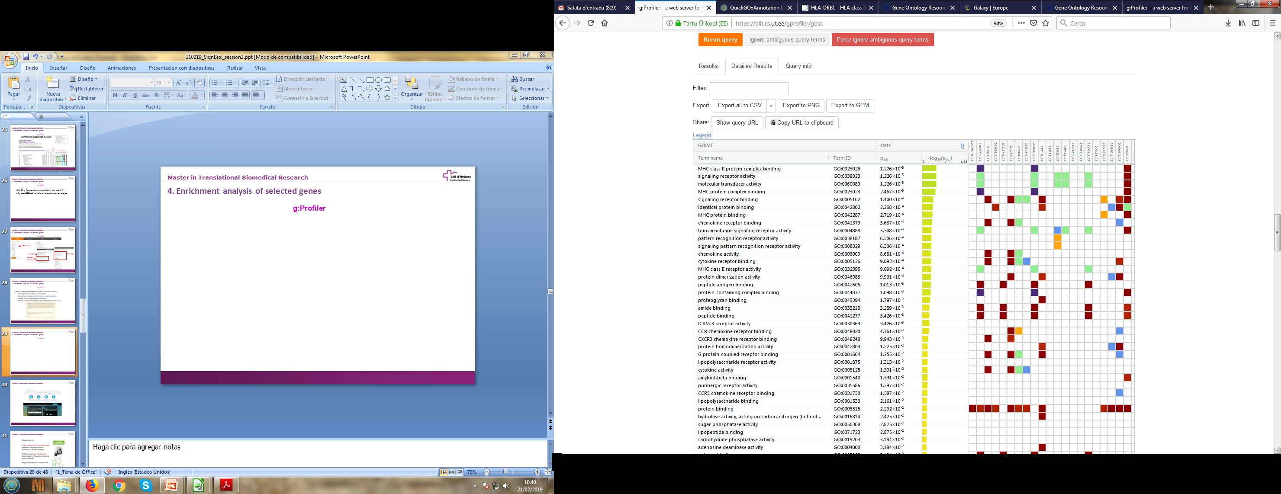
4. Enrichment analysis of selected genes
g:Profiler

Slide 51
4. Enrichment analysis of selected genes
GOrilla
http://cbl-gorilla.cs.technion.ac.il/
Direct visualization of enriched terms in hierarchy
Needs to specify the universe
Only for GO
Gene/Protein names as input

Slide 52
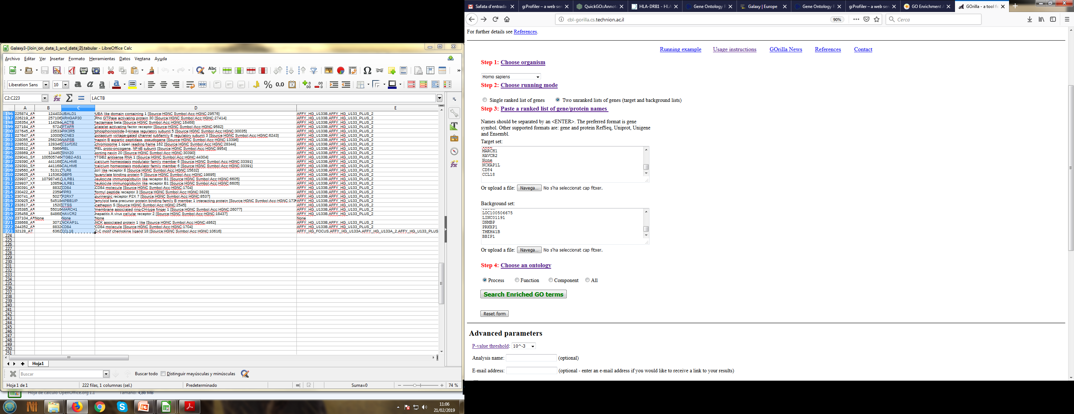
4. Enrichment analysis of selected genes
GOrilla
http://cbl-gorilla.cs.technion.ac.il/
Gene list
Universe (take it from file topTab_GSE7586_annot.csv)

Slide 53
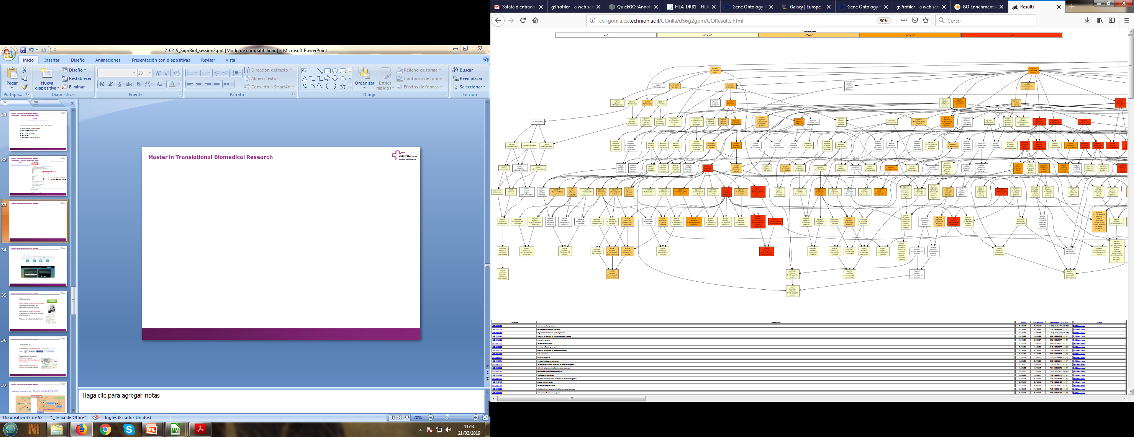

Slide 54
6. Reactome Pathway Enrichment analysis of selected genes
Try with your dataset (list of genes): selected_logFC_reactome.csv
What pathways are enriched below FDR < 0.05?
Which has the major number of matching entities? What is its hierarchy?
Explore “Diseases” section: are there similar pathways found in other infections?
…?

Slide 55
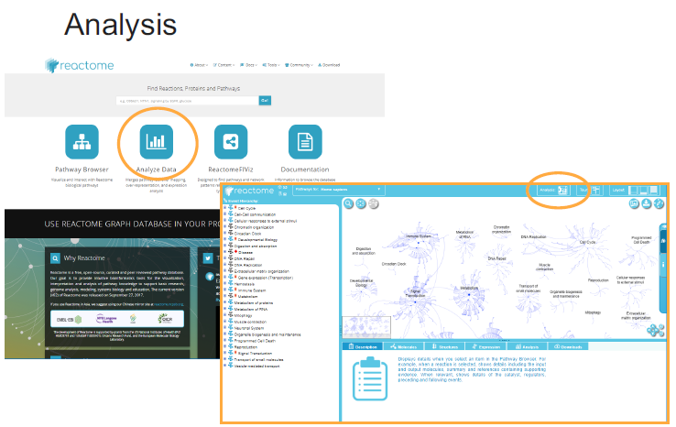
5. Introduction to Reactome and Pathway visualization
Familiarize with Reactome using example data

Slide 56
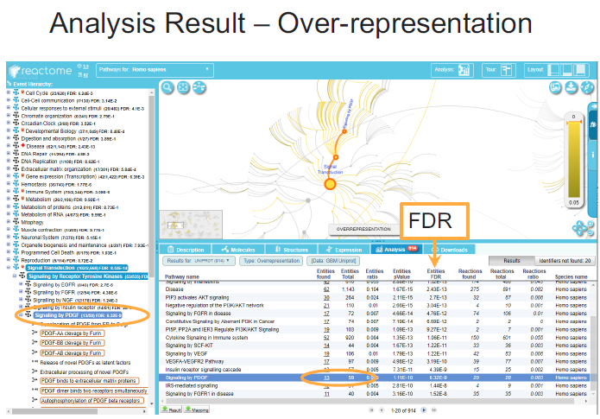
5. Introduction to Reactome and Pathway visualization

Slide 57
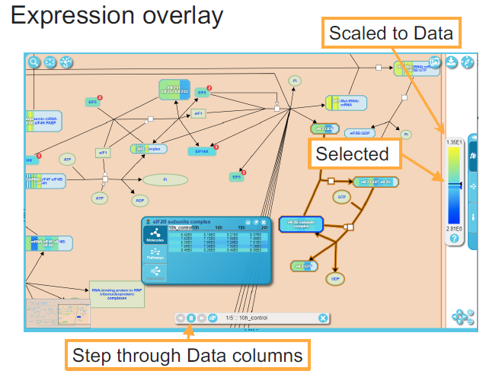
5. Introduction to Reactome and Pathway visualization

Slide 58
Visualization and downstream analysis
REVIGO
EnrichmentMaps
Pathview

Slide 59
REVIGO is a web-based tool that can take our list of GO terms, collapse redundant terms by semantic similarity, and summarize them graphically.
Visualization of pathways of interest
EnrichmentMaps

Slide 60
A workflow in R
clusterProfileR

Slide 61
Workflow gsea with clusterprofiler:
https://learn.gencore.bio.nyu.edu/rna-seq-analysis/gene-set-enrichment-analysis/
https://hbctraining.github.io/DGE_workshop_salmon/lessons/functional_analysis_2019.html
https://hbctraining.github.io/DGE_workshop/lessons/functional_analysis_other_methods.html
http://biit.cs.ut.ee/gprofiler/page/r

